Slide 1
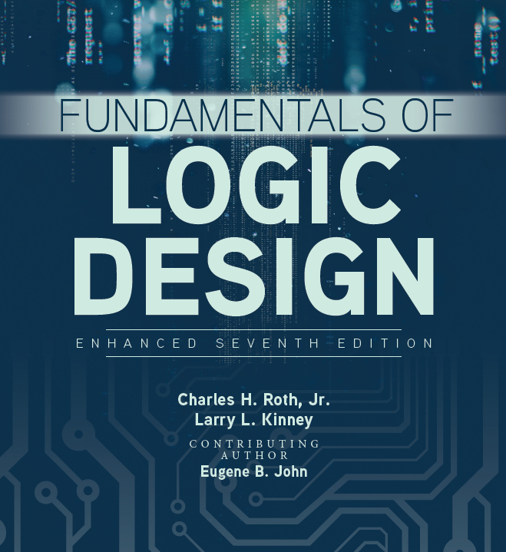

Unit 5
Karnaugh Maps

Slide 2
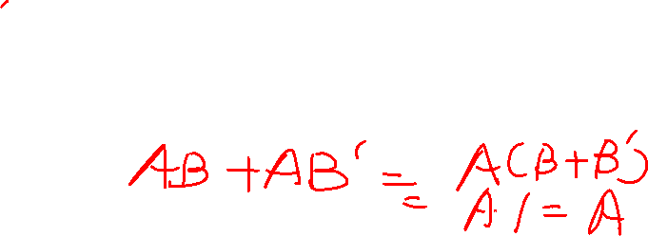
Karnaugh Maps
A Karnaugh map is a systematic way of simplifying switching functions and lead directly to minimum cost two-level circuits composed of AND and OR gates.
A K-Map is a collection of squares where each square represents a minterm. In total there are 2^n squares.
Adjacent squares differ in the value of one variable

Slide 3
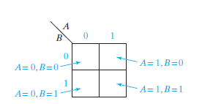
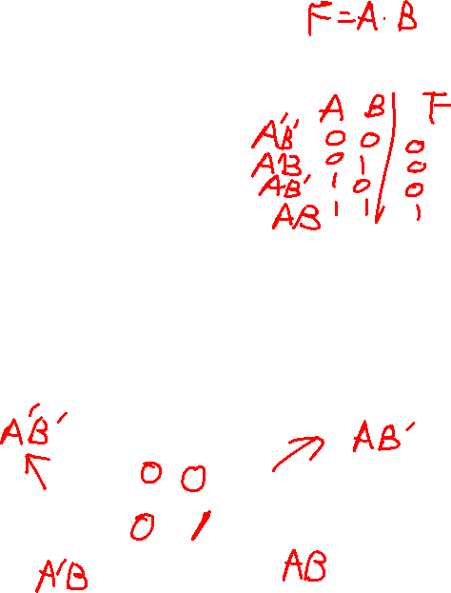
Two- and Three-Variable Karnaugh Maps
Karnaugh Maps:
A Karnaugh map is a systematic way of simplifying switching functions and lead directly to minimum cost two-level circuits composed of AND and OR gates.
It specifies the value of the function for every combination of values of the independent variables.
Two variable K-map →

Slide 4
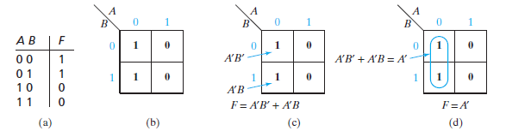
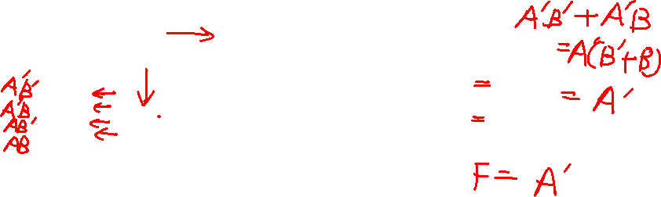
Two- and Three-Variable Karnaugh Maps
Two Variable Karnaugh Maps:
Note that the value of F for A = B = 0 is plotted in the upper left square, and the other map entries are plotted in a similar way in the figure below (Figure 5-1 in book).
Each 1 on the map corresponds to a minterm of F. For example, a 1 in square 01 indicates that A’B is a minterm.
Minterms in adjacent squares of the map can be combined since they differ in only one variable.

Slide 5
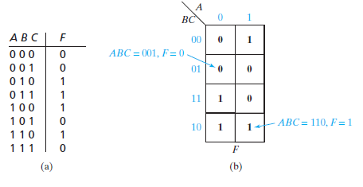
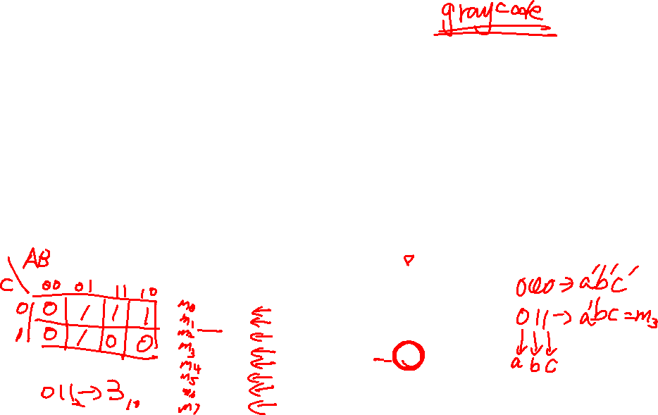
Two- and Three-Variable Karnaugh Maps
Three-Variable Karnaugh Maps:
A three-variable Karnaugh map can be plotted in a similar way to the two-variable map.
The value of one variable, A, is listed on the top and the vales of the other two, B and C, are listed on the side.

Slide 6
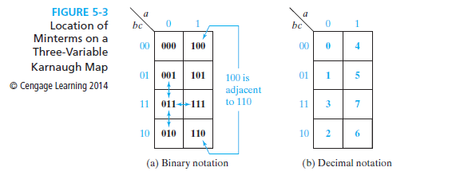
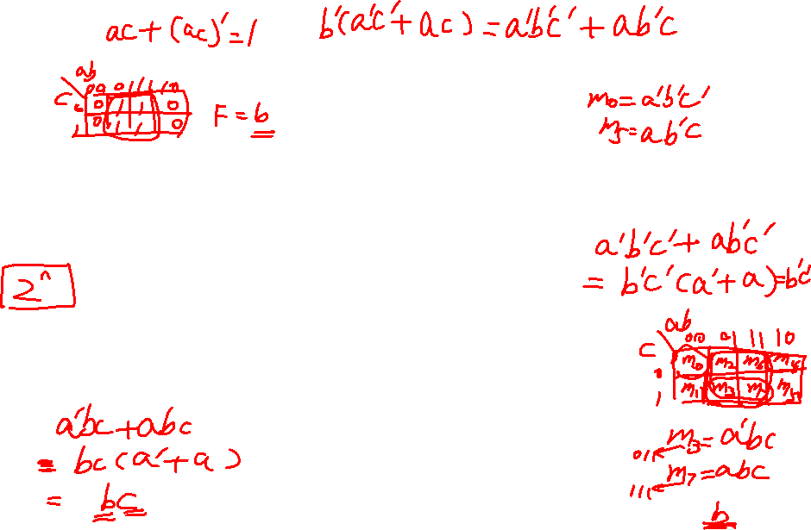
Two- and Three-Variable Karnaugh Maps
Locations of Minterms on a Karnaugh Map:
Minterms in adjacent squares of the map differ in only one variable and therefore can be combined using the uniting theorem XY + XY’ = X.

Slide 7
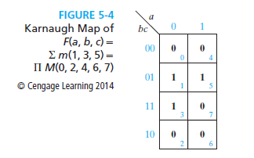
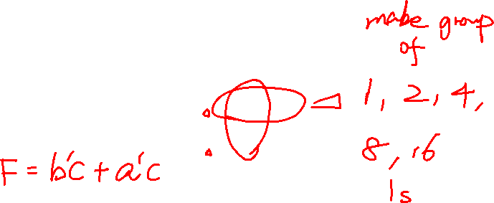
Two- and Three-Variable Karnaugh Maps
Mapping Minterm and Maxterm Expressions on Karnaugh Maps:
Given the minterm or maxterm expansion of a function, it can be mapped on a Karnaugh map as follows:

Slide 8
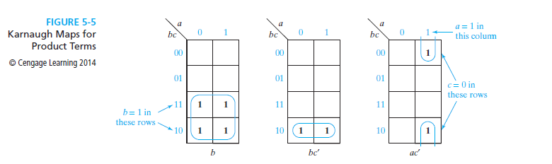
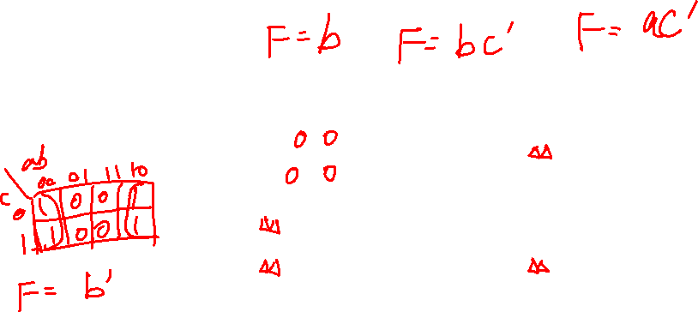
Two- and Three-Variable Karnaugh Maps
Plotting Product Terms:
To plot the term b, 1’s are entered in the four squares of the map where b = 1 as shown below:

Slide 9
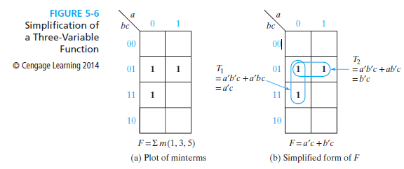
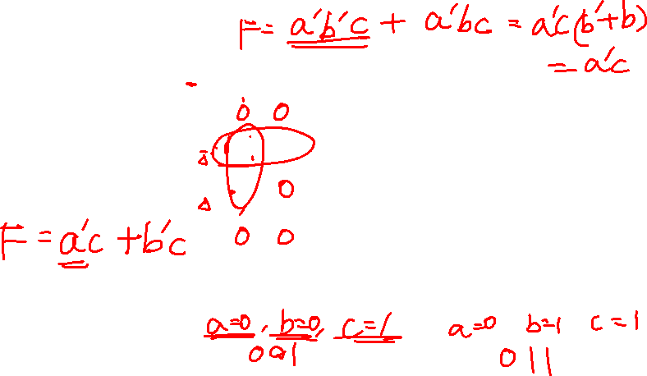
Two- and Three-Variable Karnaugh Maps
Simplifying Expressions:

Slide 10
Two variable K-map
The optimized expression obtained from K-map is always expressed in sum of products or product of sums forms
Thus, the expression is realizable using two-level logic circuit implementation
Two-variable K-map:
X
Y
0 1
m₀ | m₂
m₁ | m₃
0
1

Slide 11

Three variable K-map
Adjacent squares of a given square represent binary combinations that differ by only one bit, i.e. gray code format
XY
Z
00 01 11 10
0
m₀ | m₂ | m₆ | m₄
m₁ | m₃ | m₇ | m₅
1

Slide 12
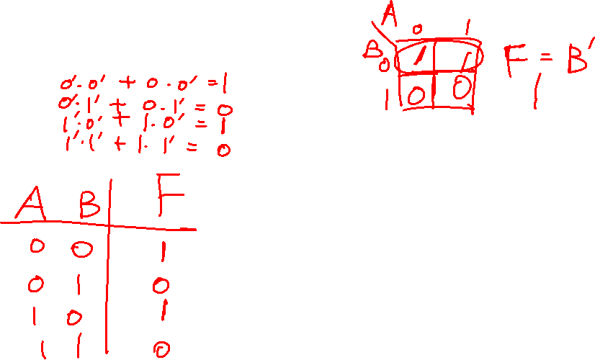
Using K-maps for simplification
F=A’B’+AB’
Truth table
K-maps
Try to group as many 1s as possible

Slide 13
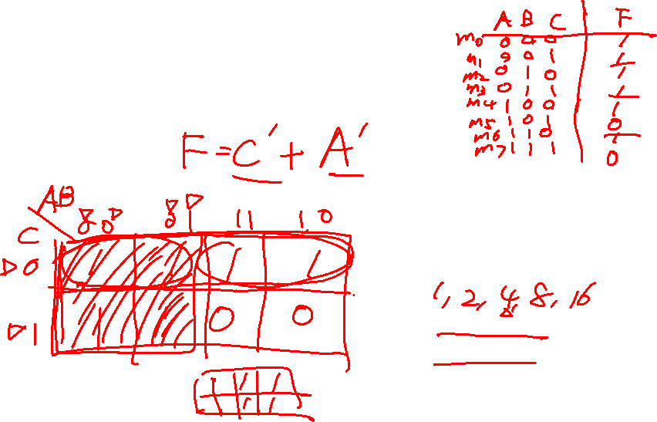
Using K-maps for simplification
F(A,B,C)=Σm(0,1,2,3,4,6)
Truth table
K-maps
Only power of 2 number of cells can be grouped
groups must be rectangle

Slide 14

Why can K-maps work?
XY+XY’=X
X(YZ+YZ+Y’Z+Y’Z’)=X
A group term is the product of all the literals that are common to the entire group.
Groups can be formed in a wrap-around manner-i.e. bottom-to-top and right-to-left
K-maps are easy to draw for up to 4 variables, hard for 5 or 6 variables. Why?

Slide 15
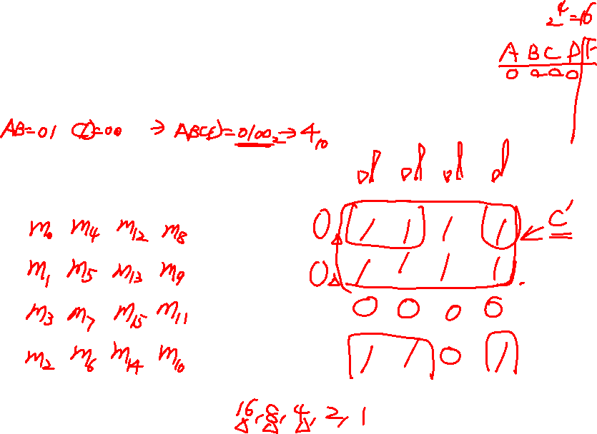
Using K-maps for simplification
F(A,B,C,D)=Σm(0,1,2,4,5,6,8,9,10,12,13)
A
A
AB
CD 00 01 11 10
AB
CD 00 01 11 10
00
01
00
01
D
D
11
C
10
B
11
C
10
B

Slide 16
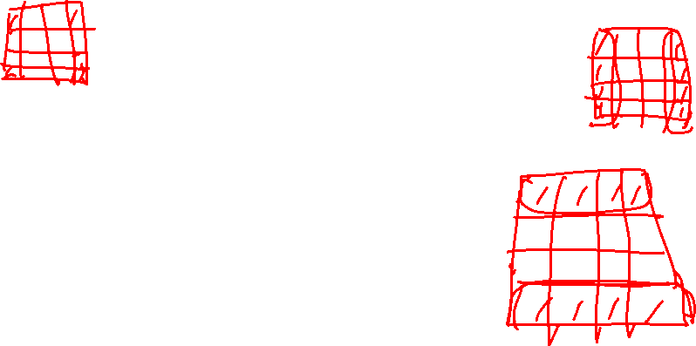
Four variable K-map
Minterms are adjacent if differ only in one literal, i.e. complemented in one and uncomplemented in another
m_{o},m₄,m₁₂,m₈ are adjacent to m₂,m₆,m₁₄,m₁₀
m_{o},m₁,m₃,m₂ are adjacent to m₈, m₉,m₁₁, m₁₀
Two adjacent squares (minterms) can be combined to form a product term with one less variable

Slide 17
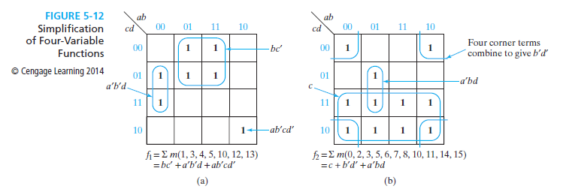
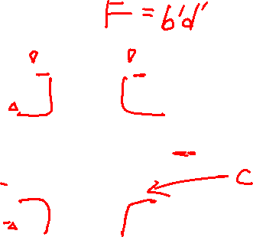
Four-Variable Karnaugh Maps
Simplifying Expressions in Four-Variable Karnaugh Maps:

Slide 18
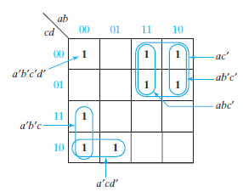
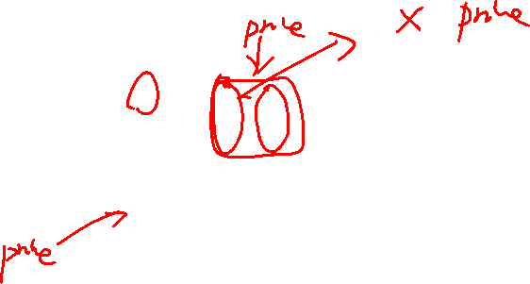
Determination of Minimum Expressions Using Essential Prime Implicants
Prime Implicants:
A product term implicant is called a prime implicant if it cannot be combined with another term to eliminate a variable.
a’b’c, a’cd’, and ac’ are prime implicants
a’b’c’d’, abc’, and ab’c’ are not prime implicants
A sum-of-products expression containing a term which is not a prime implicant cannot be minimum.

Slide 19
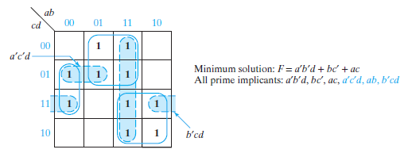
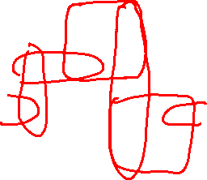
Determination of Minimum Expressions Using Essential Prime Implicants
Determination of All Prime Implicants:
The minimum solution may not include all prime implicants, as shown below:

Slide 20
Determination of Minimum Expressions Using Essential Prime Implicants
Essential Prime Implicants:
If a minterm is covered by only one prime implicant, that prime implicant is said to be essential, and it must be included in the minimum sum of products.
In order to find a minimum sum of products from a map, we should first loop all of the essential prime implicants.

Slide 21
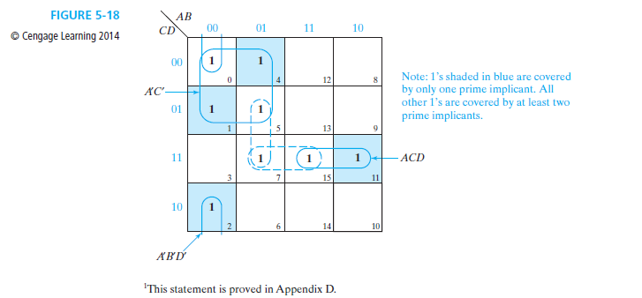
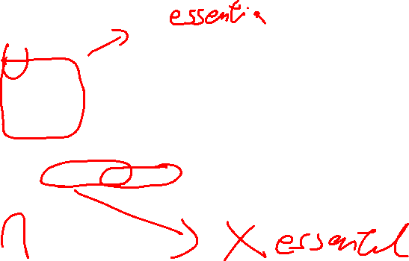
Determination of Minimum Expressions Using Essential Prime Implicants

Slide 22

Determination of Minimum Expressions Using Essential Prime Implicants
Procedure to Obtain a Minimum Sum of Products from a Karnaugh Map:
Find all prime implicants
Include all essential prime implicants
Include other prime implicants to cover all minterms not yet covered. Try to minimize the overlap between the prime implicants

Slide 23


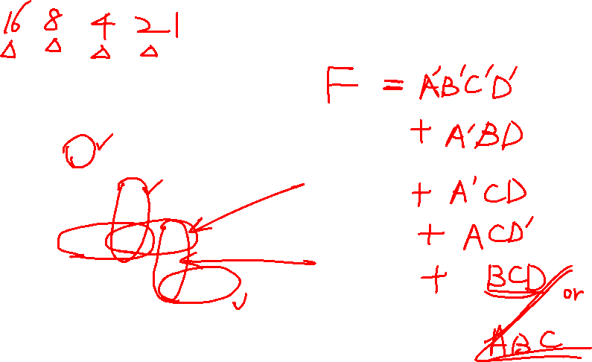


Determination of Minimum Expressions Using Essential Prime Implicants
A
AB
CD 00 01 11 10
1 | 0 | 0 | 0
0 | 1 | 0 | 0
1 | 1 | 1 | 0
0 | 0 | 1 | 1
00
01
D
11
C
10
B

